Slide 1


Read Write Inc.
Teaching Phonics at The Firs
September 2026
‹#›

Slide 2
Why Read Write Inc
Phonics?
Tried and tested over many years
A systematic, structured and evolving programme
Regular built-in assessment to check progress
A one-to-one support programme
Early success in reading
Training and ongoing support for staff
“When children can’t read there is low self esteem. We want them to be reading with confidence, to be able to read quite sophisticated texts at an early age.”
Ruth Miskin – former headteacher and creator of Read Write Inc.
‹#›
Notes:
As a school we want to ensure that all our children are successful readers.
We use the RWI programme because it is very rigorous and with its focus on assessment and differentiation it helps children of varying abilities to make good progress:
• It has been tried and tested over and over again in schools across the country.
• It is systematic, well structured and therefore results in children rapidly learning sounds & blending.
•There is a built in system to regularly assess progress being made by each child.
•There is a 1 to 1 support programme to prevent children falling behind
•Training & development for staff is an ongoing part of the programme.
•It is built around some central beliefs including the need for a rapid pace of learning, praise and encouragement for children and a passion for reading

Slide 3
Who is it for?
Children from 4 years who are starting school – Read Write Inc. is a ‘start-up’ reading programme
The programme also supports older children, developing their fluency and comprehension at a rapid rate
‹#›
Notes:
Read Write Inc. lasts just over two years for most children, if they start the programme in Reception.
It also supports children who join the programme at a later point or who are experiencing differing learning difficulties.

Slide 4
What is phonics?
Way of teaching children how to read and write
All words are made up of individual sounds. These sounds are merged together to form words.
c-a-t= cat
sh-i-p = ship
l-igh-t= light
ph-o-n-i-c-s= phonics
Notes:
Phonics is a method of learning to read. Phonics works by breaking each word up into it’s individual sounds before blending those sounds back together to make the word. So for ‘mat’, you would say m-a-t- mat and for ‘ship’, you would say sh-i-p- ship. This means that children don’t have to memorise thousands of words individually.
A sound that is spoken is called a ‘phoneme’ and a sound that is written is called a ‘grapheme’.

Slide 5
English Alphabetic Code
44 sounds but only 26 letters
Letters work singly, in pairs or threes
In RWI, when 2 or 3 letters are grouped together to make a sound, we call them Special Friends
Over 150 ways to represent the 44 sounds.
‹#›
Notes:
We use 44 sounds to make all the words in the English language.
However, we only have 26 letters.
The 26 letters work singly, in pairs ( ou, or) and sometimes in threes to represent one sound (igh, air). When two or three letters are grouped together to make a sound, we call them ‘Special Friends’
In English, we have more than 150 ways to represent 44 sounds, using the 26 letters in the alphabet.
Click
This makes our language one of the most complex in the world!

Slide 6
‘ai’ sound
train
day
cake
sleigh
straight
baby
rein
reign
‹#›
Notes:
This shows 8 different ways of writing the /ay/ sound. It shows just how complex the English language is.

Slide 7
Speed Sounds Set 1 and Set 2
We start by teaching the children just one way of reading and writing the 44 sounds. Here they are on the Simple Speed Sounds chart.
‹#›

Slide 8
Consonants: stretchy
f | l | m | n | r | s | v | z | sh | th | ng
 |  |  |  |  |  |  |  |  |  | nk
Consonants: bouncy
b | c | d | g | h | j | p | qu | t | w | x | y | ch
 | k
Vowels: bouncy
Vowels: stretchy
a | e | i | o | u | ay | ee | igh | ow
oo | oo | ar | or | air | ir | ou | oy
Set 1 sounds
Set 2 sounds
‹#›
Notes:
We teach Set 1 sounds first - these are the sounds highlighted yellow.
We teach letter sounds, not letter names so ‘a’ as in ‘apple’ not ‘ai’.
Some of the sounds are stretchy and some are bouncy. The difference is that with the stretchy sounds, you can hold onto the sound and the bouncy sounds you can’t.
It is common to confuse letters which have similar shapes e.g. b, d, p and i, j.
Don’t worry if your child has difficulty pronouncing some sounds. Many children have a few sounds they find difficult to say. They can easily learn to read, as long as we know what sound the child is trying to say. You can help your child by encouraging him or her to look at your mouth when you say the sound or to look in a mirror at their mouth shape.
Once children are confident at recognising Set 1 sounds, we then teach Set 2 sounds (sounds highlighted blue).

Slide 9
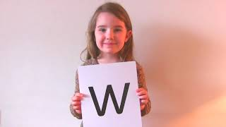
Pure sounds (ruthmiskin.com)
Sound Pronunciation Guide
How to say the Set 1
sounds
Notes:
We teach using pure sounds. A pure sound is where you try not to add the ‘uh’ on the end (‘m’ not’ muh’, ’s’ not ‘suh’, etc.) so that your child will be able to blend the sounds together to make words more easily.
You can watch this film of little Sylvie on the Ruth Miskin website to practise using pure sounds.

Slide 10
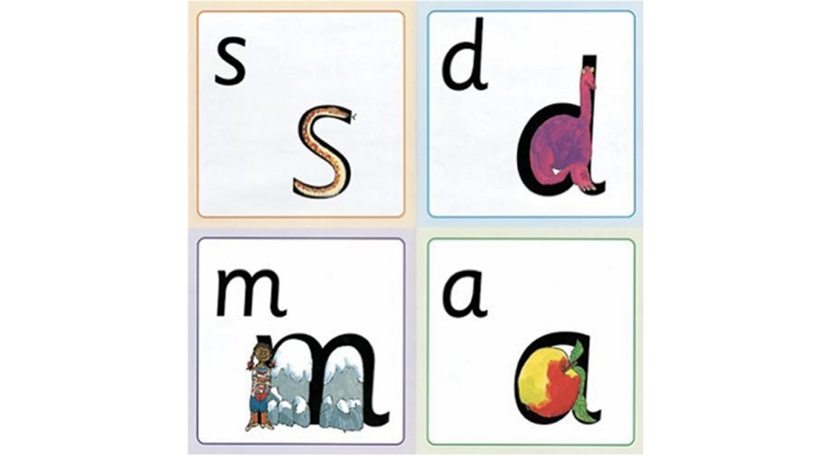
Name the pictures
Notes:
The reason why RWI works so well is that there is a hook to learn the sounds as they use pictures which are the same shape as the letter.
‘s’ looks like a snake.
‘d’ looks like a dinosaur.
‘m’ looks like a mountain.
‘a’ looks like an apple.
We teach the children to name the pictures before they learn the sound. So when they see the grapheme ‘s’, they can visualise ‘snake’ and then say ‘s’ or for ‘d’, they visualise the dinosaur and say ‘d’. When you’re sat with your child practising the sounds in their green Set 1 Speed Sound book, if your child looks at a grapheme and can’t remember the sound, encourage them to recall the picture and then hopefully, they’ll be able to say the sound. If not, tell them the sound and the more they practise, the better they’ll get.

Slide 11
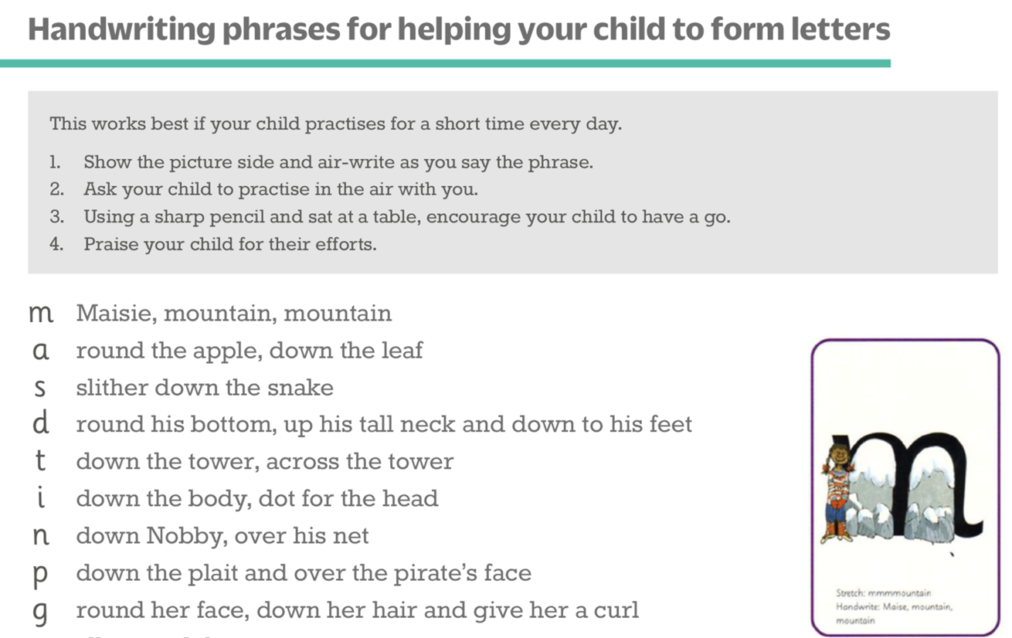
Teaching letter formation
Notes:
At the same time as learning to read each sound, children also learn how to form each letter correctly.
Each sound has a handwriting phrase e.g. ‘Maisie, mountain, mountain’ for ‘m’.
We suggest you use these handwriting phrases when practising writing at home with your child. These were included in the Sounds folder. It’s so important to sit with your child to check they are forming the letter correctly- bad habits are difficult to break!
Avoid using these phrases to read the sound so when reading the sound ‘p’, we say ‘pirate’ but when writing ‘p’, we say ‘down the plait and over the pirate’s face’.

Slide 12
Teaching letter formation (cont)
Each sound has a handwriting phrase
Avoid using these phrases to read the sound.
When your child is practising handwriting at home:-
sit with your child to check they are forming the letters correctly
use the handwriting phrases

Slide 13


Holding a pencil
We encourage the children to use a tripod grip. We pretend the thumb and forefinger are the crocodile’s jaws and the 3rd finger is the ‘log’ for the crocodile to sit on.
Fine motor activities are great for developing muscle strength in the fingers.
The Stabilo Easygraph pencil helps to develop correct pencil grip.
Notes:
-We encourage the children to hold a pencil using a tripod grip as this is deemed the most comfortable. It’s best to encourage this whilst they are young as it’s hard to undo bad habits when they are older. To help the children, we pretend the thumb and forefinger are the crocodile’s mouth and he sits on the log which is the 3rd finger.
-In order to hold a pencil correctly, a child needs to have developed muscle strength in their fingers. Fine motor activities really help with this- there are lots of ideas on the internet. We highly recommend using a Stabilo Easygraph pencil as it has grooves for the fingers and is triangular shaped.

Slide 14

Oral Blending
Ability to blend spoken sounds into words
Prerequisite skill for reading
We use Fred the Frog to help as Fred can only speak in sounds! He says the sounds and they say the word!
Oral blending- Fred's bedroom
Notes:
Oral blending is the ability to blend spoken sounds into words.It is the prerequisite skill for reading.
We use Fred the Frog as Fred can only speak in pure sounds. He says d-o-g, h-a-t etc.
Speaking like Fred helps children to understand that words are made up of sounds.
Fred helps children practise blending sounds together because he needs the children to say the words for him. Fred says d-o-g, children tell him the word is dog.
This is how we quickly teach all of our children to blend.

Slide 15
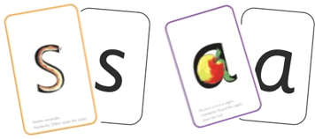

Sounds and Blending = Reading
+
Once a child can recognise the first five sounds (m, a, s, d, t) and s/he can orally blend, they will be able to read:-
sat sad mat mad Sam at as
Sounding out a word and blending those sounds together is called Fred Talk
Reading words- WT 1.6 (5mins 22)
Notes:
Alongside teaching children letter sounds, we teach them to blend sounds to read words e.g. s-a-t, sat. They Fred Talk the word first by sounding out the word and then blend those sounds together to read the word. The letters are taught in a particular order because they are the most common and several words can be made using just a few letters.

Slide 16
f | l | m | n | r | s | v | z | sh | th | ng nk
ff ph | ll le | mm mb | nn kn | rr wr | ss se c ce | ve | zz s | ti ci
b | c k | d | g | h | j | p | qu | t | w | x | y | ch
bb | ck ch | dd | gg |  | g ge dge | pp |  | tt | wh |  |  | tch
a | e | i | o | u | ay | ee | igh | ow
 | ea |  |  |  | a_e ai | y ea e | i_e ie i | o_e oa o
oo | oo | ar | or | air | ir | ou | oy | ire | ear | ure
u_e ue ew |  |  | oor ore aw au | are | ur er | ow | oi
‹#›
Notes:
Once the children know one way of reading and spelling each sound, the children are then taught Set 3 sounds (sounds in pink) which are alternative ways of spelling each sound. For example, they know ‘ay’ and now learn a-e and ai as other spellings for the same sound.
As mentioned previously, there are more than 150 graphemes and this chart shows the 100 most common graphemes.

Slide 17
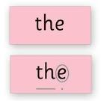
Red Words
These are words which have a tricky sound e.g. ‘said’ ‘want’
Children need to learn these words by sight
In the early RWI books, these words are printed in red.
‹#›
Notes:
We teach the children what the ‘tricky’ sound is. As children need to memorise Red words, they will need lots of opportunities to see them and practise them.

Slide 18

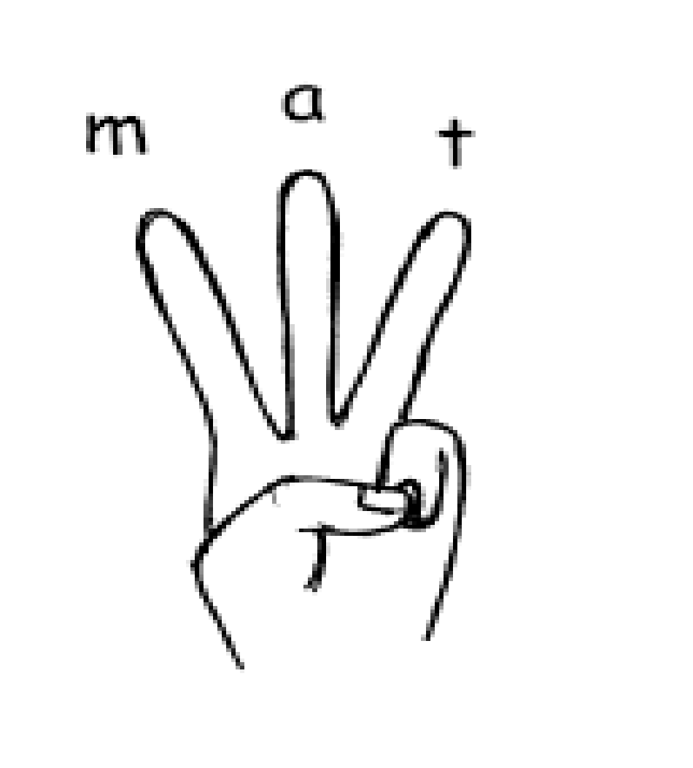
Spelling
We use Fred to help the children to learn to spell as well!
They convert a whole word they hear into individual sounds- we call this ‘segmenting’.
In spelling, we call them ‘Fred Fingers’. We tell them how many Fred Fingers they need, they squeeze the sounds they hear in the word on their fingers and then write the word down.
Spelling using Fred Fingers WT 1.6
‹#›
Notes:
It is a tool so they will be able to spell any word.
It means they do not have to memorise lists of spelling words.

Slide 19
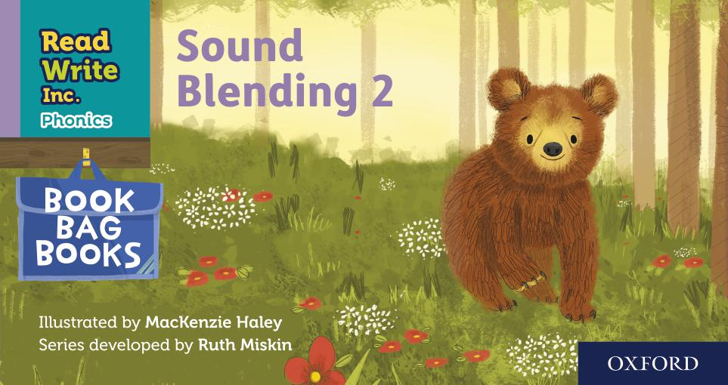
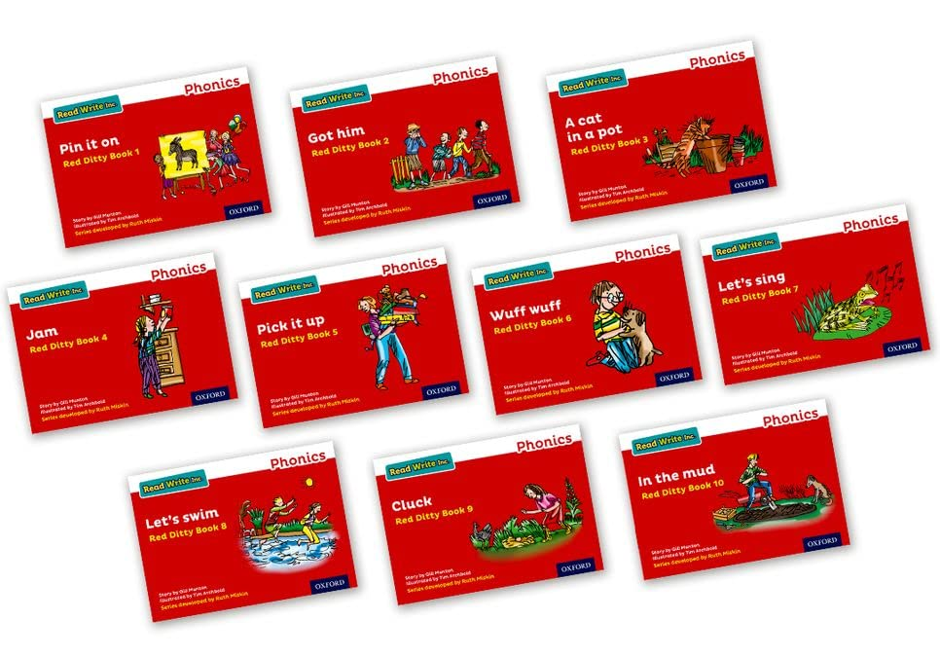
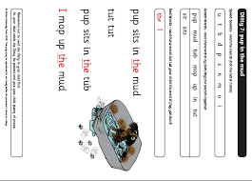
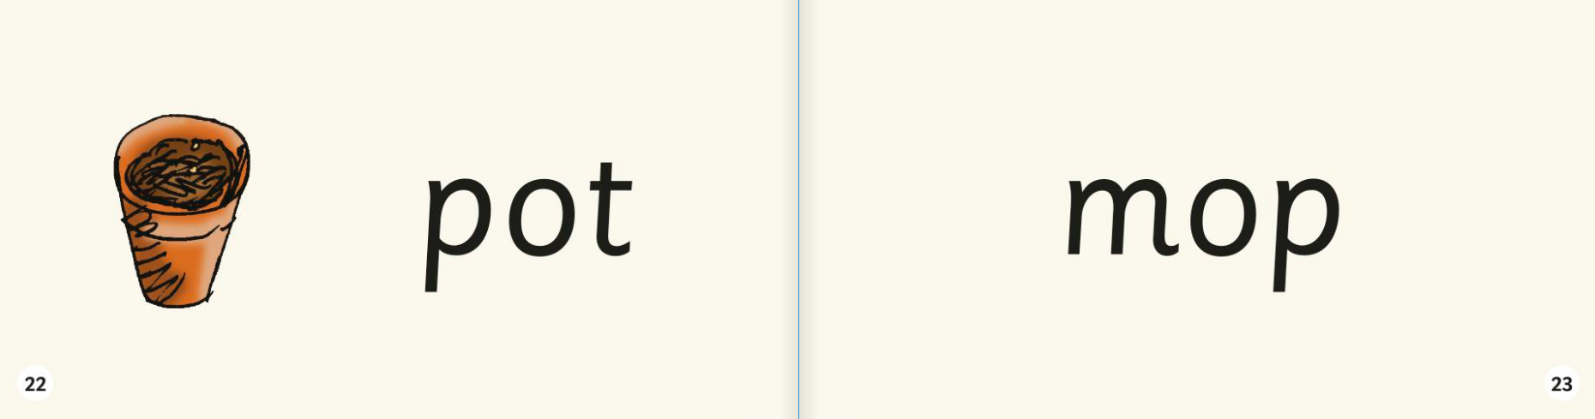


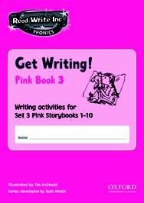
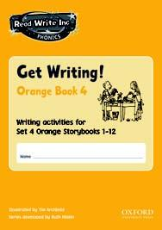
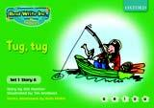
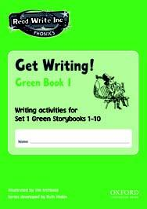

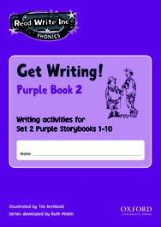





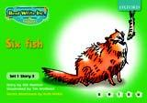
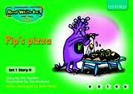

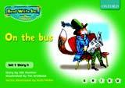





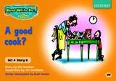
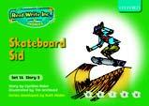


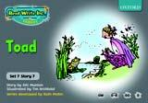
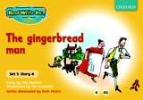
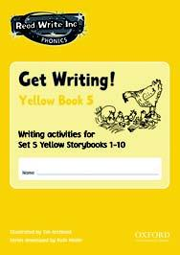
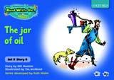
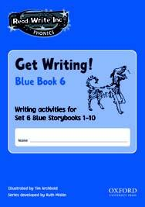
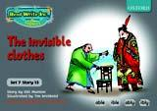
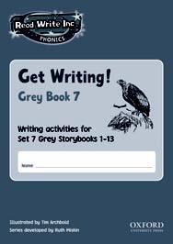
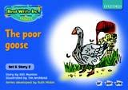
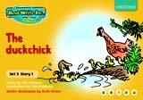



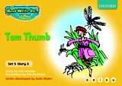
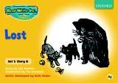
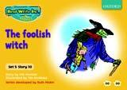

Storybooks and Get Writing Books
‹#›
Notes:
Every day, your child will read and write the words that contain the sounds and graphemes they have learned so far, using lively, fun phonic storybooks and a Get Writing book. Hold up some Storybooks and Get Writing Books.
-Hold up picture books – as part of our literacy programme in YR we have been sending home some picture books without words. This provides a really valuable and hopefully enjoyable time to spend with your child, developing reading skills such as creating narrative, predicting what will happen next and talking about the setting and the feelings of characters etc.

Slide 20
The Three Reads
Reading first to practise decoding
Reading a second time to develop more reading speed and to ensure they understand the text
Reading a third time to develop a story-telling voice
‹#›
Notes:
-Over three days, the children encounter each text three times, working with their reading partner.
-They read it first to practice decoding the text
-The second day they focus on comprehension, often with the teacher modelling the process.
-The final reading is to bring the text to life by adding intonation or story voice.

Slide 21


So how can you help your child?
Support your child to complete the daily sound sheet
Encourage your child to join in with fine motor activities to develop hand strength
Regularly look at the Set 1 Speed Sound book together
Use pure sounds, not letter names
Play Fred games
Listen to your child read the reading material in their popper wallet
Encourage your child to watch Virtual Classroom lessons sent home
+
‹#›
Notes:
Support your child to complete the daily sound sheet- point to each picture so your child can tell you what it is. In the first box, your child needs to practise the letter whilst saying the handwriting phrase and in the second box, they need to say the letter sound whilst writing it. It is so important to sit with your child so you can make sure they are forming the letters correctly and checking they are holding their pencil correctly.
Regularly look at the Set 1 Speed Sound book together- when practising the sounds, do them out of order. If you show the grapheme and your child doesn’t know it, encourage them to try and think of the picture, turn over the page if necessary, then go back to the grapheme.
Use pure sounds, not letter names- remember not to add ‘uh’ on the end of the sound.
Play Fred Games- A list of Fred Games was sent home in the Sound Folder. These are great for helping children to develop the skill of oral blending.
Listen to your child read the reading material in their popper wallet- your child will have read the RWI book in their wallet so they should read this with confidence and enjoyment! The Book Bag Book is an unseen book so your child may need a bit of support with this. At the moment, books come home on Wednesdays but the day and frequency with which a book comes home may change depending on what part of the programme your child is on but we’ll keep you fully informed along the way.
Encourage your child to watch Virtual Classroom lessons sent home- We have been sending home a Virtual Classroom film for each sound and the idea is that your child watches the film and joins in.
Regularly check eBooks and quizzes assigned on Oxford Owl- When children start a Red book, we’ll assign it as an eBook and also assign a quiz which goes with it. The Red books will also be sent home as a paper copy so you can choose how your child reads it. Feedback from parents is that children really enjoy the quizzes.

Slide 22

And...
By reading to your child lots of lovely stories that are at a higher level than your child can read yet and having lots of discussion!
Use these prompts at the end
of each page or paragraph:
What is happening in
this
part of the story?
What do you think
will happen next?
What is that character thinking?
What do you think that
character is feeling now?
What is that character saying?
‹#›
Notes:
If parents ask us how they can help at home, we tell parents that the most important thing you can do is to read to your child every day. Reading good quality texts such as Room on the Broom and Stickman will introduce your child to vocabulary they might not hear in everyday conversations. You can also talk about the story which will help your child’s comprehension of the text.

Slide 23
And...
By talking to your child as much as possible and ‘feeding’ them new and different words:
By enriching conversations through description:
“Look at that rain. It looks like little diamonds hitting the window pane!”
“Let’s eat our lunch now.”
“Let’s scoff our lunch now.”
“Let’s munch our lunch now.”
“Wow that’s a big dog!”
“Wow that’s an enormous dog!”
“Wow that’s a massive dog!”
‹#›
Notes:
1.A rich vocabulary is essential for high levels of comprehension.
2.The more words your child has in his/her head when they come to school, the quicker their understanding (comprehension) when they learn to read (decode) those words.
3.If they encounter a rich vocabulary when talking to adults & in their reading, they will begin to use it in their writing too.
4.As part of the RWI programme we focus on helping children to develop the depth of their vocabulary by encouraging them to use more interesting and powerful alternatives.

Slide 24
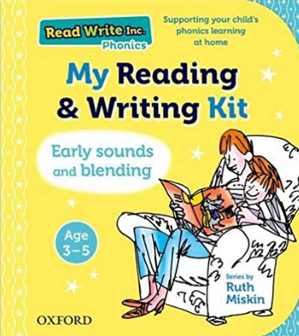
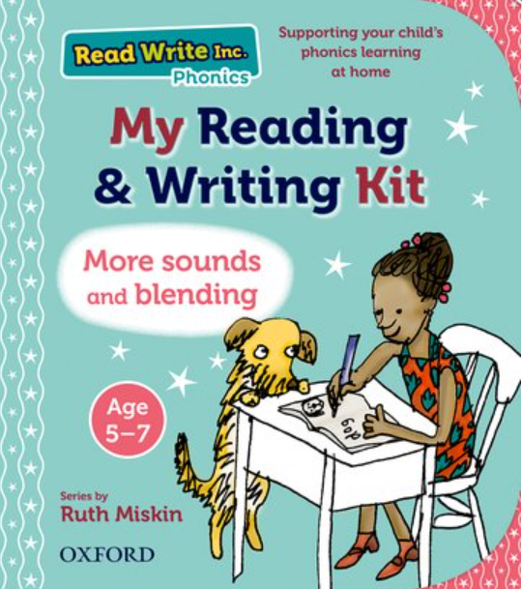
And...
By having a look at the ‘Learning To Read At Home’ page on the web for tips and resources for supporting your child at home:
RWI- Information for parents
RWI resources- OUP (RWI resources are published
by Oxford University Press)
‹#›
Notes:
The two websites here give very useful guidance for teachers and parents alike as well as resources if you want to access or purchase them.
There is also guidance for parents on our website which we hope is useful.

Slide 25

Mrs Mercer
‹#›

